Slide 1
Emotional Intelligence
Train the Trainers Workshop

Slide 2
Workshop Objectives
By the end of this course, you will be able to:
Define emotional intelligence by participating in a group discussion about emotions.
Effectively apply self-awareness strategies by creating a self-awareness action plan.
Participants will be able to apply strategies to improve self-regulation by analyzing and discussing scenarios.
Outline strategies for developing self-motivation by creating a list of small, measurable, and realistic goals.
Apply empathy-building strategies by answering questions after reading a case study.
Explain strategies that improve social skills by developing a list of social skill improvement methods.
Apply current practices in delivering training by creating one ten-minute video where the potential trainer is demonstrating how to deliver the training material by using an emotional intelligence topic of their choosing.
Notes:
Welcome participants to the workshop and introduce yourself.
List the workshop objectives.
Invite participants to introduce themselves in the chat by listing their name, how long they have been with the company, what they hope to gain from this workshop, and if they could travel anywhere in the world, where would it be?

Slide 3
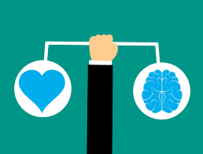
What is Emotional Intelligence (EQ)?
Emotional Intelligence
We define Emotional Intelligence (EQ) as the ability to:
Recognize, understand, and manage our own emotions
Recognize, understand, and influence the emotions of others
Notes:
Understanding and developing your emotional intelligence is essential if you want to successfully progress in your career. Both your career and personal life will be enhanced by developing your emotional intelligence. So let's start at the beginning. What exactly do we mean by emotional intelligence? I want everyone to take a moment and think about what emotional intelligence means to you. When you think you have an idea, please raise your hand and we’ll discuss it together. (Whole-group discussion)
Great job everyone. Now let’s take a look at the definition of emotional intelligence. We define emotional intelligence as the ability to recognize, understand and manage our own emotions and recognize, understand and influence the emotions of others. This means being aware that emotions can drive our behavior and impact people both positively and negatively. Learning how to manage our emotions and the emotions of those around us will enhance our emotional intelligence and make us more productive.

Slide 4
Managing Emotions
Emotional Intelligence
Managing emotions is especially important in situations when we are under pressure. For example, when we are…
Giving and receiving feedback
Meeting tight deadlines
Dealing with challenging relationships
Navigating change
Working through setbacks and failure
What other situations may we need to manage emotions?
Notes:
Managing emotions is especially important in situations when we are under pressure. For example, when we are giving and receiving feedback, meeting tight deadlines, dealing with challenging relationships, not having enough resources, navigating change, working through setbacks and failure. It’s a scientific fact that emotions precede thought. When emotions run high, they change the way our brains function…diminishing our cognitive abilities, decision-making powers, and even interpersonal skills. Understanding and managing our emotions (and the emotions of others) helps us to be more successful in both our personal and professional lives. What other situations may we need to manage emotions in the workplace? Please type your ideas in the chat.

Slide 5
Emotional Intelligence is sometimes known as EQ.
Emotional Intelligence
EQ stands for emotional quotient.
Emotional version of general intelligence
Measured on 4 criteria:
Being aware of emotion
Expressing emotions
Controlling your emotions
Handling relationships with others effectively
Notes:
Emotional Intelligence is sometimes known as EQ. It looks very similar to IQ, which stands for intelligence quotient and is a common measure of intelligence. It measures a person’s reasoning ability and it is believed to be genetic.
Emotional Intelligence is very different. With EQ, we are understanding and expressing our emotions and being empathetic when communicating with others. Emotional intelligence is the emotional version of general intelligence. EQ is measured on 4 criteria: being aware of emotions, expressing emotions, controlling your emotions, and handling relationships with others effectively. All these elements come together to help us solve problems and make decisions. Also, where IQ is a stable, fixed part of your adult life, emotional intelligence can be learned and grown throughout your life. All you have to do is be open to understanding it and practicing the skills needed to get better at it.

Slide 6
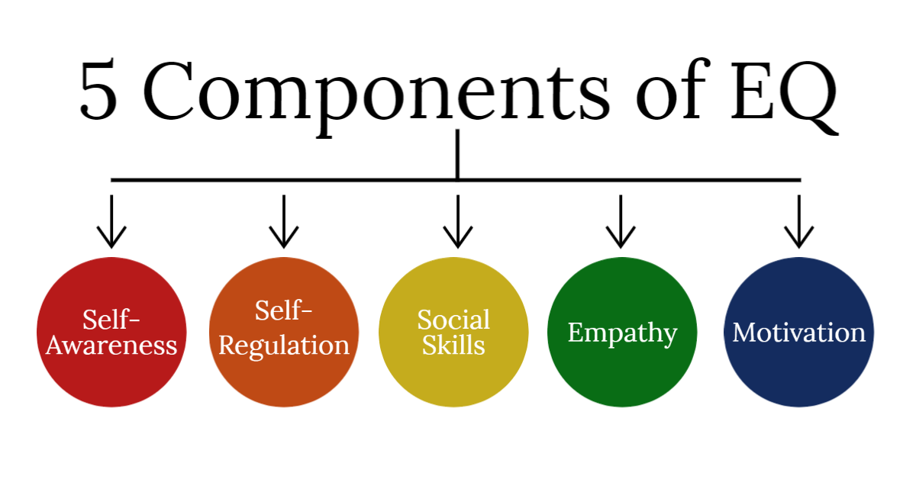
Self-Awareness
Notes:
The American psychologist and science journalist Daniel Goleman first coined the term emotional intelligence. Goleman’s Emotional Intelligence theory comprises five core components: empathy, effective communication or social skills, self-awareness, self-regulation, and motivation. You can easily familiarize yourself with the skills that make up emotional intelligence, but it can take some time and practice to apply it to both your personal and professional life. It is important to learn and understand how to manage your emotions and actions by practicing emotional intelligence concepts. It’s what will help you succeed in all aspects of your life.

Slide 7
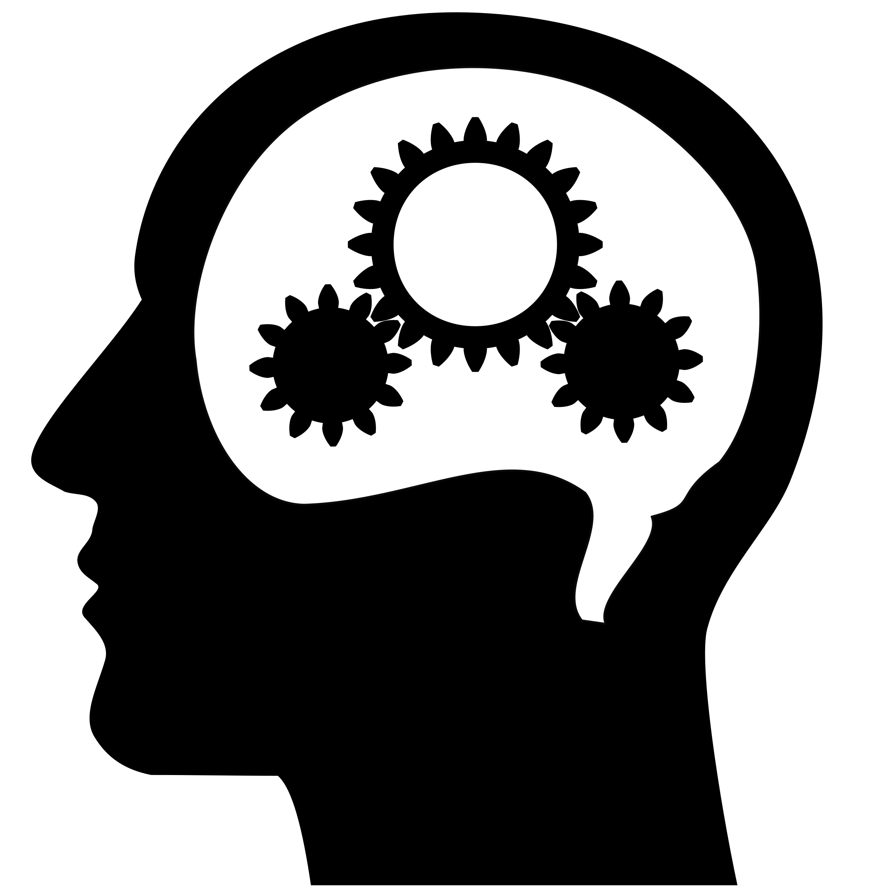
Self-Awareness
What is self-awareness?
Recognition of personal strengths and weaknesses
Questioning your emotional state and thoughts before acting
Helps you quickly understand why you feel a certain way and how it affects others
Notes:
Let’s take a closer look at one of the five elements of emotional intelligence: self-awareness. To be self-aware means you have a full recognition of your personal strengths and weaknesses. You know when to step back and question your emotional state and thoughts before acting on something. This is an important part of EQ because being able to do this means you can very quickly understand why you feel a certain way and how it affects others. This is an essential skill that you should be aware of and practice frequently. It will help you become a better leader and decision maker as well as improve your relationships both in the workplace and in your personal life.

Slide 8
Self-Awareness
BELIEFS
Trust, faith or confidence that
something is true
The first step in building self-awareness is understanding and identifying your beliefs.
Notes:
In our lives, we get into situations where we quickly feel something is either right or wrong. It could be witnessing a co-worker being berated by upper management, or your supervisor instructs you to do something a specific way, but you feel in your heart that another way would definitely be more productive. Typically, we have thoughts about situations immediately, even though we don’t have all the facts. The feeling that you have that something is true is based on your beliefs. Beliefs are your trust or faith in something or someone. You accept that it’s true because of your ingrained beliefs. Because our beliefs are so strong and ingrained in us, we react quickly to a situation by thinking or saying specific things. Most of us at one time have jumped to conclusions, but we don’t always take the time to evaluate these thoughts.
Our beliefs are important because it’s the first step you need to take to build your self-awareness. Having a good sense of self-awareness will help you manage emotions and make accurate assessments of a situation. Being self-aware also builds confidence. Knowing and understanding what your beliefs are will help you interact with others appropriately. If you want to build your self-awareness, you need to make a conscious effort to identify and understand the strong beliefs that you have.

Slide 9
Self-Awareness
Identifying your beliefs
Think of a recent negative event you have experienced.
What was the event?
Write down what you remember from the event in an objective way.
What do you believe to be true about the situation?
What were the consequences of your beliefs?
Take out the "Belief Identifier" worksheet in your participant guide.
Notes:
Let’s complete an exercise together to help you with identifying your beliefs. I'd like you to think of a time when you've had a negative experience lately.
First, what was the event that led to you reacting negatively. Write down as much as you can about the event but try to be objective with no emotional attachment to the scenario or people involved. If the event was someone running a stop sign and almost hitting you while you were on your way to the store, write down what happened in an objective way without mentioning your thoughts or feelings about it. Just write the facts and not how you feel about the event or how you reacted.
Next, identify your beliefs. What do you believe to be true about the situation? In this example, your belief may be that the other person's behavior is inconsiderate, dangerous and wrong. You may have even stronger beliefs and think the person driving the other car is a horrible person and shouldn't be allowed to drive. This is where you will write down your thoughts and feelings about the situation and the other person/persons involved in the event.
Finally, what were the consequences of your beliefs? What happened in this situation because of your beliefs? How did you behave when it was happening? What was the impact of your behavior? In the example of the driver, maybe you felt anger start to rise and you couldn't stop thinking about how wrong they were in the situation. Maybe you were angry the rest of the day and continued to dwell on it or found yourself in a bad mood. Maybe the event affected your daily routine or productivity.
Find the worksheet titled, "Belief Identifier" in your participant guide. I want you to take about 6 minutes to complete the exercise. You will then be put into breakout rooms, where you will discuss with each other how your event shaped your beliefs. I will go around to each breakout room to see how everyone is doing with the exercise. Does anyone have any questions? Ok wonderful, let’s get started.
Welcome back everyone. You all did a wonderful job with this exercise. After completing this exercise, hopefully you have a better understanding of how to identify your beliefs and how they affect your behaviors. Our reactions to events are caused by our beliefs and not the event alone. You can complete this exercise on your own, reflecting on a positive event also, as this will help you identify positive and negative beliefs. When you find yourself in challenging situations, take some time to complete this task after the event, reflecting on your beliefs and the impact they had on the situation. This practice will help you to enhance your self-awareness over time.

Slide 10
Reflection
Self-Awareness
Taking time to consider your thoughts and feelings about the world around you
Take out the "Reflection" worksheet in your participant guide.
Notes:
Reflection is an important step in building self-awareness and you can practice it on your own whenever you need to. So what is reflection? It's taking the time to consider where you are at, events that have happened around you, and your feelings and thoughts about it. It can be a positive or negative experience. Reflecting on it will help us understand our thoughts and feelings, how you fit into the situation, and what you can do to shape it.
I would like everyone to complete the following reflection exercise. Please take out the worksheet titled, "reflection worksheet" found in your participant guide . Due to time constraints, I want you to fill out 3-5 sections. You can complete the rest on your own and as often as you need, to help you practice reflection. For every section, write an area of your life that's important to you. As an example, you may want to focus on areas like your career, financial situations, family, or relationships. Include areas of your life that are important to you right now. Next, for each segment on a scale of one to 10, rate how satisfied you are with that part of your life. One would be not satisfied at all, 10 would be extremely satisfied.
On the second part of the document, you are going to reflect on one thing you want to change and how you can do this. Maybe you want to get better at managing your bank accounts. How can you do this? One way would be to check your bank statement twice a week or maybe you will make an effort to itemize your bills. Fill in the box stating what you'd like to change. You can complete this exercise once a month so you get a really good sense of how you're feeling about different aspects of your life.
I want you to take about 6 minutes with this activity and then we will discuss your thoughts on the process.
Now that you have completed the activity, what did you think about this exercise? Was it helpful? Why or why not? Do you think you’ll use it in the future?

Slide 11
Self-Awareness
The Ripple Effect
when someone's actions affect someone else, which in turn affects other people
Notes:
Think about what would happen if you witnessed your co-worker being berated publicly by the supervisor in the office in front of other colleagues. Even though you are not the one being yelled at or bullied, you will have feelings of anxiety, being uncomfortable, anger, uneasiness, being scared or confused. This event turns into a negative ripple effect that affects everyone in the room and even those that hear about the situation after it occurs. The supervisor was clearly not thinking how their actions were going to affect everyone else. After this negative event, you and your colleagues will think and feel different things. You might be worried about having to interact with the supervisor and how they will treat you. You may feel stressed and have low productivity that day. Everyone may feel so worried about making a mistake that they are now feeling fear whenever they get up in the morning to go to work. The ripple effect is when someone's actions affect someone else, which in turn affects other people.
When you are not yourself, experiencing pressure at work, or struggles at home or with your health, self-regulation can be difficult. You will need to learn ways to regulate your emotions in order to enhance your self-awareness and improve your EQ. The workplace should be a safe environment where people are treated with respect and feel comfortable coming to you with problems or concerns.
We probably notice how the ripple effect is created by others, but don’t pay attention to our own nearly as much. Next time you witness either a negative or positive event, pay attention to the effects it has. How did it affect others, what was the outcome? When you get good at noticing and observing other ripple effects around you, you can become more aware of your own.

Slide 12
Asking for Feedback
Self-Awareness
Be clear.
Be specific.
Ask for honesty.
Take notes.
Reflect.
Notes:
Asking for feedback is important in the workplace and other areas of your life and is essential to enhancing your self-awareness. It can be frightening to ask for feedback when you are afraid of what people will say. Remember, you don’t just ask your supervisor for feedback, you can also reach out to colleagues and others. Feedback will give you useful takeaways that you can apply to bettering yourself, the situation, or the project you are working on. Here are some tips for asking for feedback:
1. Make sure you are clear in what you are asking for feedback on. Get right to the point and only provide necessary details.
2. Be very specific. This makes it easier for the person you are seeking feedback from to understand your needs and respond accordingly.
3. Ask the person to be honest with you. It may be difficult for the person to be honest and for you to accept their honesty, but it is the only way you can grow.
4. Take notes. Write down their suggestions and input. Feedback is your opportunity to learn and grow and see how others perceive you.
5. Reflect. Review everything you received from your discussion. Organize it and highlight the changes you can start implementing right now. If some changes require more time, break it down into chunks to make them more manageable. You can also show your changes to the person who gave you feedback to see your progress.
Asking for feedback and making good use of it will help you perform better in the workplace and help you better your relationships.

Slide 13
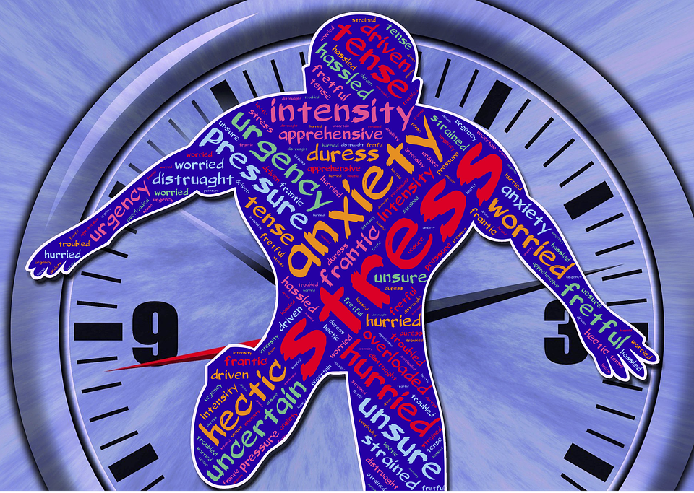
How Does Stress Affect Us?
Self-Awareness
Take out the "Stress Identifier" worksheet in your participant guide.
Notes:
Most of us experience stress at one time or another in our daily lives. Some people may have more stress than others and our stress levels can go up and down at different times in our lives. A helpful way to deal with stress is to create strategies to help us deal with stressful situations. Let’s complete a stress strategy worksheet together.
Find the worksheet titled, "Stress Identifier" in your participant guide. Answer the following questions on the worksheet: 1. How do you know when you’re stressed and how does it make you feel? 2. What particular situations trigger stress for you? What happens when you are experiencing stress? Does your behavior change? What are your physical symptoms? Finally, how do you react when you feel stress? Are these reactions helpful? Take 6 minutes to fill out your stress identifier tool.
Great job everyone. Do you think this tool will be useful to you? How can you apply this tool to help you in the workplace when you are dealing with stressful situations?

Slide 14
Self-Awareness
Self-Awareness Action Plan
Choose 3 strategies below to enhance your self-awareness:
Identifying Beliefs
Reflection
Ripple effect of your actions
Reducing stress
Seeking feedback
Take out the "Self-Awareness Action Plan" worksheet in your participant guide.
Notes:
In order to enhance your self-awareness, you will need to create a plan detailing how you are going to do this. If you want to enhance your self-awareness, you need to create a plan detailing how you will do this. Find the worksheet titled, "Self-awareness action plan" in your participant guide. I want you to choose 3 strategies to help you enhance your self-awareness. You can choose from identifying beliefs, reflection, the ripple effect of your actions, reducing stress, and seeking feedback.
For your first strategy, write down your action step. What is it you want to do to enhance your self-awareness? Be as specific as you can, focusing on one strategy that can help you. Do you want to reduce stress? Communicate better with others? Build better self-confidence?
Next, write your goal. What is it you want to achieve? Do you want to practice asking for feedback more often? Find better coping skills to deal with your stress?
Now write down your success criteria. What does success toward your goal look like? This could be asking for feedback once a week, or practicing your new coping skill.
Next, identify the support system you will use to help you take this action. Choose the people you know you can count on when you need extra help or a listening ear.
Finally, write down when you will take this action step and achieve your goal. It's important to have a timeframe to work towards to keep you headed in the right direction.
Once you've completed this for your first strategy, choose two more. Focus on these 3 at first, and as you get better at it, you can add more to work on. Your action plan will only benefit you if you actually make use of it. Take some time to complete at least one action step. While you are doing that, I will be putting everyone in break out rooms. After completing one action step, discuss with your group what you came up with.
Great job everyone. We are finished with our first element of emotional intelligence. Now we are going to take a look at our next element of EQ which is Self-Regulation.

Slide 15
Self-Regulation
Notes:
Pose the question:
In terms of emotional intelligence, what is self-regulation?
Play video

Slide 16
Self-Regulation
What is Self-Regulation?
Why is Self-Regulation Important?
Notes:
As we saw in the video, self-regulation happens when we adjust internally to external stressors.
To be more specific, it’s “about acknowledging the emotions, accepting their existence, understanding their causes, and managing them. It is about how well you regulate or channelize your emotions to have the ideal temperament in any overwhelming situation, positive or negative” (Shah, 2020).
And another simpler definition is “understanding how your emotional state is impacting your decision-making” (Faulkner, 2022).
So, why is self-regulation important?
Take responses from attendees.
“Self-regulation…improves communication, engagement, and productivity” (Faulkner, 2022).
Self-regulation can help you better handle conflicts and improve stress management. (Thompson, 2022).

Slide 17
Self-Regulation
Self-Regulation Skills
Create space.
Notice your feelings.
Naming your feelings
Accepting the emotion
Practicing mindfulness (Klynn, 2021)
Notes:
There are several skills that can help you improve self-regulation
Creating space: when you feel things are starting to spiral out of control, taking a moment to step back before reacting.
Noticing your feelings or acknowledging those feelings
Then you can take that a step further and name what feelings are trying to takeover. Is it anger, frustration, sadness?
Accept that emotion, but don’t let it take over.
Finally, practicing mindfulness.

Slide 18
Self-Regulation
Strategies to Improve Self-Regulation
Identify and reduce triggers.
Tune into physical symptoms.
Consider the story you are telling yourself.
Engage in positive self-talk.
Make a choice about how to respond.
Look for positive emotions.
Seek out a therapist. (Klynn, 2021)
Notes:
How can you improve self-regulation?
Identifying and reducing triggers. Pay attention when you start to feel emotions taking over. What started it? If you notice it’s the same scenario, activity, or person each time, those could be a trigger. Knowing what those are can help you mentally prepare ahead of those types of interactions in the future.
Tune into physical symptoms. It may sound silly, but being hungry or tired could be the root cause of your emotions taking the lead.
Consider the story you are telling yourself. Try not to make assumptions or “fill in the blanks” of a situation yourself.
Engage in positive self-talk. It’s easy to become negative, especially to ourselves. Try being as encouraging to yourself as you would be to a friend in a similar situation.
Make a choice about how to respond. By recognizing that you have a choice in how to respond rather than reacting on impulse, you can change how you respond.
Look for positive emotions.
Finally, seek out a therapist. If you find it’s difficult to employ these strategies on your own, there is no shame in seeking out a therapist to help.
Pose the question.
Can anyone think of any additional strategies that could be helpful?
Would anyone like to share an experience applying any of these strategies?

Slide 19
Self-Regulation
Amy’s alarm did not go off this morning. When she realizes the time, she jumps out of bed, rushing around to get ready. As she’s driving to work, a car pulls out in front of her causing her to spill her coffee. By the time she arrives at the office, she is fuming. Her manager spots her arriving late and reprimands her. She apologizes and makes her way to her desk. As she is putting her things away a coworker makes the comment, “you’re supposed to drink your coffee, not wear it,” which causes some others nearby to chuckle. Amy snaps at them, “Can everyone just get off my back?!”
1. Did Amy show good self-regulation?
2. Why or why not?
Notes:
Now we are going to break out into groups. Read through these scenarios and discuss the questions for each in your groups.
Once you have done this, we will discuss as a group and see if everyone agrees on how these situations were handled.

Slide 20
Self-Regulation
Samantha is a cashier at a grocery store. While scanning a customer’s items, an item rings up significantly more expensive than the price listed on the shelf. The customer becomes angry and accuses Samantha of trying to swindle him out of his hard-earned money. He demands to speak with Samantha’s manager. Samantha responds by apologizing and asking a coworker to check the price on the shelf. Once the price has been confirmed and Samantha adjusts the item to the correct price, the customer begins to calm down.
1. How did both Samantha and the customer handle self-regulation?
2. How may the situation have differed if Samantha had not used self-regulation?
3. What strategies could the customer have used to better self-regulate?

Slide 21
Self-Regulation
Susan and Bob have been working on a presentation for a company-wide quarterly meeting. They decide to divide the work and work on their respective sections separately. They schedule a time to meet to go over their work the day before the meeting. Susan arrives on time for their meeting, but Bob is 10 minutes late. Once Bob arrives, they start reviewing their slides. It is clear that Bob has only done about half of what he was supposed to have completed. Susan asks Bob where the rest of the slides are. Bob replies that he figured they could just work the rest out together.
1. How could Susan reply that would show bad self-regulation?
2. How could Susan reply that would show good self-regulation?

Slide 22
Take a Break
Notes:
Allow participants to take a 15 minute break. Announce time when instruction will resume.

Slide 23
Self-Motivation
What is self-motivation?
Pursuing goals with energy and persistence
Elements of Self-Motivation:
Self-Esteem – The general set of beliefs we have about ourselves
Locus of Control – how much people believe they have control over their life situations and experiences
Incentives – positive gestures we give ourselves in exchange for good work
Notes:
Let's take a look at another element of emotional intelligence: self-motivation. What does self-motivation mean to you? (they can verbally respond or type in the chat). Sometimes in our lives we have difficulty getting started on tasks or even procrastinating. We put goals on the back burner, putting off dreams, and postponing tasks that need to get done. These are things most of us are guilty of doing. So how can we get past this? The first thing we can do is to adopt small motivation habits. There are 3 essential elements of self-motivation: self-esteem, locus of control, and incentives. Self-esteem are beliefs we have about ourselves. How does this shape our motivation? Well, if we don't believe we can accomplish a task due to low self-esteem, we are not going to feel motivated to even get started or put much effort into it. But if you do belief in yourself, you have the capacity to feel highly motivated to complete your task and complete it well.
Another element of self-motivation is locus of control. This refers to how much people believe they have control over their life situations and experiences. To motivate yourself, you have to believe that factors outside of your control have no bearing on your success. Focus on the things you can control and believe that your work matters so that you have the required motivation to get it done including preparing for the unknown.
Finally, there are incentives. They are positive gestures we give ourselves in exchange for good work. It is important to celebrate our wins no matter how big or small. Motivating ourselves with incentives increases our changes of achieving the goals we set for ourselves. These basic elements will help you practice better habits and take action.

Slide 24
Self-Motivation
Visualize your Goals
Get Comfortable.
2. Choose a situation important to you.
3. Imagine the result you want.
4. Use your senses to visualize the desired outcome.
5. Take a mental picture.
6. Decide on your action steps.
Type responses in the chat.
How does visualizing your goals help you be more motivated to achieve them?
Notes:
Visualization helps us to stay motivated. To do this, you will simply form a mental image in your mind. You can visualize pictures, scenarios, speaking with your co-worker, or a finished product.
There are 6 action steps you can take to create your own personalized visualization. First, get into a comfortable position, free from distractions. Close your eyes and think of a situation in your life you want to improve. This could be completing a project, speaking to a co-worker about something important, asking for feedback, or any other area in your life you want to see an excellent result from, especially one you are struggling to stay motivated to complete or even begin altogether. Next, picture the result you desire. What does that look like to you? Take a mental snapshot of that. This will help you retain it. Finally, open your eyes and begin to think about your action steps for completing your visualized goal. What did you think of this exercise? How does visualizing your goals help you be more motivated to achieve them? Type your responses in the chat.

Slide 25
Self-Motivation
Motivate Yourself to Start
Set small, manageable goals to build momentum.
Mark on your calendar.
Track your progress.
Reward the big and little wins.
Give yourself an out.
Notes:
The biggest challenge with self-motivation, is getting yourself to start. Let's take a look at 5 tips to help us achieve this. First, you want to come up with a goal you want to achieve. If your goal has multiple parts, break it down into manageable chunks and set separate small goals within the larger one. For example. If your goal is to complete the company newsletter by Friday, you can break this down into chunks by setting smaller, more manageable goals. You can say, I will complete phase 1 of the newsletter by today, phase 2 by tomorrow, and phase 3 by Thursday. Friday, I will proofread and make any necessary corrections. Setting manageable goals will help keep you motivated. Next, mark on your calendar when you will start and complete these goals. Having that visual will keep you on track and motivated to continue. Next, track your progress. Keep a document available with all steps that need to be completed that you can check off as you finish them. Make sure you reward yourself with big and small wins. These are the incentives we spoke about earlier. Think about what incentives will help keep you motivated. Maybe it's stepping away from your desk to get a snack from the breakroom, or speaking to a co-worker for 5 minutes or even texting your children to see how their day is going. Whatever works for you is what will help keep you motivated. Finally, give yourself an out. This doesn't always mean abandoning the project or goal completely, but stepping away to give yourself a break and start on something different. It could also mean reaching out to others for help, when it is not going well and you feel overwhelmed. Just make sure it's whatever you are comfortable with.

Slide 26
Self-Motivation
Setting small, manageable, realistic goals
Cut your goal in half.
Break your workday into timed chunks.
Take small breaks.
Take out the "Goal" worksheet in your participant guide​.
Notes:
When you learn to set smaller, more realistic goals, you will be able to achieve more. There are 3 ways you can apply this concept. The first thing you can do is to cut your goal in half. The purpose of this is to halve your goal into smaller, concrete tasks you can start right away. For example, if you are in charge of producing the entire technical manual for the new copier machine, you can start by just producing the project timeline. This will make the project less daunting and give you something you can begin now. Second, break down your workday into timed chunks. This is a time-management approach. Give yourself a time limit for working on one particular part of the project. Let's say 25 minutes, separated by five-minute breaks. You will set a timer for those 25 minutes, and then take a 5 minute (non-work related) break. By making your time block small, you will feel less overwhelmed and you will have a more manageable goal. Finally, take small breaks throughout the day. This can be a 30 second stretch standing at your desk, to getting up to walk around and talk to your colleagues, or getting a snack. Taking breaks helps your mental acuity and keeps you motivated.
Now we are going to practice setting, small, manageable, realistic goals. Take out the "Goal Worksheet" found in your participant guide. I will be putting you in break-out rooms where you will work with your team to create a plan of how you would break your day down into manageable, timed, chunks. Your team will think of a goal, and then use the steps discussed here to make it realistic and manageable. Complete the worksheet together and we will come back and share what you have come up with.
Examples of what your goal could be:
Cleaning the house before your book club arrives
Having a dinner party
Completing a college research paper
Great job everyone. What did you think of this activity? How will applying these steps help you stay motivated?
(Participants can raise their hand or answer in the chat).

Slide 27
Empathy
Let’s Define Empathy
Empathy is the ability to understand and share the feelings of another.
Why is Empathy Important?
Empathy is important because it helps us understand how others are feeling and helps us to know how to respond to the situation.
Empathy helps to enable sharing of experiences, needs, and desires between individuals and providing an emotional bridge that promotes prosocial behavior (Riess, 2017).
Notes:
Let’s Define Empathy:
Empathy is the ability to understand and share the feelings of another.
Why Is Empathy Important?
Empathy is important because it helps us understand how others are feeling and helps us to know how to respond to the situation.
Empathy helps to enable sharing of experiences, needs, and desires between individuals and provides an emotional bridge that promotes prosocial behavior( Riess, 2017).
In your own words, describe what empathy is to you.
Describe a time where you believed you displayed empathy.
Do you feel comfortable with displaying emotions and having a caring attitude?

Slide 28
Empathy
The Three Types of Empathy :
Cognitive Empathy
Emotional Empathy
Empathic Concern
Notes:
The Three Types of Empathy :
•Cognitive
•Emotional
•Empathic Concern
In your own words, define what you believe each empathy is. You can raise your hand or type in the chat.

Slide 29
Empathy
Cognitive Empathy
This is the ability to understand another person's perspective
Example
You have a friend that didn’t get a job that they interviewed for. Your friend is disappointed and down about it. You being their friend can understand why they are feeling disappointed
Notes:
Cognitive Empathy
This is the ability to understand another person's perspective.
Example of Cognitive Empathy:
You have a friend that didn’t get a job that they interviewed for. Your friend is disappointed and down about it. You being their friend can understand why they are feeling disappointed.
Now that we have viewed the video, what are 2 things you have taken away from the video?
Using the signs given, do you believe you have developed any sort of cognitive empathy?
How do you believe you can incorporate this in everyday life?

Slide 30
Empathy
Emotional Empathy
Example
The ability to physically feel what another person feels
When you feel deeply in your soul a person’s emotions. If they are grieving, you feel the same sense of grief.
Notes:
Emotional Empathy
This is the ability to physically feel what another person feels.
Example of Emotional Empathy
This is when you feel deeply in your soul a persons’ emotions. If they are grieving, you feel the same sense of grief.
Describe a time where you believe you displayed emotional empathy?

Slide 31
Empathy
Empathic Concern
This is the ability to sense what another person feels and take action to make a difference or to help
Example
A friend loses money that was for their electric bill. You feel their pain, so in turn you give them money to pay their electric bill.
Notes:
Empathic Concern
This is the ability to sense what another person feels and takes action to make a difference or to help.
Example:
A friend loses money that was for their electric bill. You feel their pain, so in turn you give them money to pay their electric bill.
After viewing the video, what are 2 things you have taken away from this?

Slide 32
Empathy
Ways to Build Empathy
Develop a curiosity about people you don’t know well.
Step outside your comfort zone.
Be open to receiving feedback.
Examine any biases you may have.
Walk in others’ shoes.
Have difficult conversations.
Join important causes.
Notes:
Ways to Build Empathy
•Develop a curiosity about people you don’t well.
•Step outside of your comfort zone.
•Be open to receiving feedback.
•Examine any biases you may have.
•Walk in others’ shoes.
•Have difficult conversations.
•Join important causes.
Let’s look at the item that states, “ develop a curiosity about people you don’t know well.” In today’s climate, a lot of people are not as open to meeting new people as well as taking the time to get to know new people. We will be going into breakout rooms for this activity. You will each share something unique about yourself or a hobby of yours . We will take 15 minutes to do this activity. If we don’t have an even number, one group may have 3 people.
Ok that was fun. So what things did you all learn from one another?

Slide 33
Empathy
Notes:
Panera Bread story
I really enjoyed this story. A lot of people would have just accepted the fact that Panera Bread doesn’t offer the clam chowder on certain days and would have found an alternative. How would you have responded if you were faced with this situation?
Has this story encouraged you in any way to make changes in your life ? Why or Why not?

Slide 34
Empathy
What type of empathy did Brandon display?
What type of empathy did the manager of Panera Bread display?
What empathy-building strategies did Brandon display?
What type of empathy-building strategies did the manager display?
Brandon’s story eventually went viral about the caring and considerate action of not only himself but of the manager as well.
Notes:
Let's answer some questions about empathy based on the video we just watched.

Slide 35
Social Skills
Communication: how we connect with others
Influence: “smoothly guiding the others toward a direction that is valuable [for both parties]” (Wind4Change, 2021).
Collaboration and Cooperation: “working with others [toward] a common goal” (Wind4Change, 2021).
Conflict Management: the art of resolving, managing, and preventing conflict.
Leadership: the ability to guide people
Change Catalyst: understanding when to initiate and how to manage change.
Building Bonds: building and maintaining meaningful relationships.
Notes:
Let’s talk about social skills. In regards to EQ, there are 7 key social skills.
Communication, put simply is how we connect with others. We all communicate in one form or another every day. Conversations, emails, text messages, comments on a video, and even facial expressions.
Influence, “smoothly guiding the others toward a direction that is valuable [for both parties]” (Wind4Change, 2021). Influence can get a little bit tricky, it’s important to remember the portion of the definition “That is valuable for both parties” otherwise it veers into manipulation.
Collaboration and Cooperation, basically teamwork. Working with others toward a common goal.
Conflict management, the art of resolving, managing, and preventing conflict. How we deal with conflict, our own and conflict around us.
Leadership, the ability to guide people. We’re all familiar with leaders, EQ can make a huge difference in the quality of leadership.
Change catalyst, understanding when to initiate and how to manage change.
Building bonds, building and maintaining meaningful relationships.

Slide 36
Social Skills
Benefits of Strong Social Skills
Meaningful Relationships
Understanding yourself and others
Increase productivity and workplace performance
Helps prevent loneliness and isolation.
Physical Health Benefits
Notes:
Having strong social skills has many benefits.
These skills help you build and maintain meaningful relationships with those around you: family, friends, coworkers.
When you have strong social skills, you are able to understand yourself and others better.
It can increase your productivity and performance in the workplace.
It helps to prevent loneliness and social isolation.
Strong social skills can even benefit your health by reducing your risk of high blood pressure and heart disease. (Cooks-Campbell, 2022).
We’ve discussed the importance of social skills, so now let’s talk about ways to improve those skills.

Slide 37
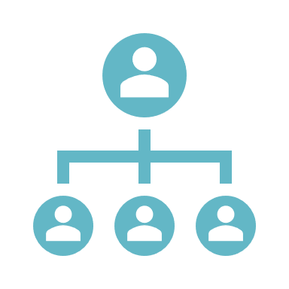
Social Skills
Activity
For each of the key social skills, think of and list 2-3 ways that you think each skill can be improved.
Communication
Influence
Collaboration and Cooperation
Conflict Management
Leadership
Change Catalyst
Building Bonds
Notes:
I want you to think of 2 or 3 ways that these key skills could be improved.
I’ll give you an example to get you started.
Practicing active listening is a strategy that can be used to improve communication.
Work on this for x minutes. Once you’re done, we will discuss the strategies you have come up with.

Slide 38
Train-The-Trainer Assessment
Training Breakdown:
Choose and research your concept
Take notes
Choose activity to assess participant understanding
Create 1-3 training slides with speaker notes
Record 10-minute video using your device camera
Upload video to YouTube, Google Drive, or similar platform
Email video to facilitator at _____________________
Choose one of the following concepts:
The importance of emotional intelligence in the workplace
Self-awareness strategies
Self-regulation strategies
Practicing empathy
Motivation in the workplace
Practicing social skills to communicate better with co-workers
Sample Assessment Activities:
Group discussions in breakout rooms
Completing graphic organizers
Answering guided questions
Exit Tickets
Answering questions in the chat
Notes:
Now that you have completed modules 1-4, you will have the opportunity to demonstrate how you would train a group of participants in one of the concepts you have learned in this course. Throughout the modules, you have participated in various group discussions and activities to help you better understand the content and apply the knowledge you have learned. For your assessment, you will prepare a mock training by choosing one of the concepts you learned about in this course, creating 1-3 slides with speaker notes, and record a 10-minute portion of your training using your device camera. You may speak as if participants are present even though they are not. Upload your video to YouTube, Google Drive, or a similar platform and provide the link to the following email: !!!!!!!!!!!@!!.
First choose from the following concepts you learned about today:
The importance of emotional intelligence in the workplace
Self-awareness strategies
Self-regulation strategies
Practicing empathy
Motivation in the workplace
Practicing social skills to communicate better with co-workers
Next you will research your concept and take notes for what you want to include in your slides.
Next, choose one activity that will help your participants meet the learning objective and allow you to assess their understanding. Some ideas for activities could include:
Participating in a group discussion using guided questions after watching a short video
Completing a graphic organizer in groups in breakout rooms
Participating in a group discussion after reading role-playing scenarios
Exit ticket question
Answering questions in the chat
You will then create 1-3 training slides with speaker notes to use in your training.
Finally, you will record a 10 minute video of yourself conducting your training using your device camera. You may speak as if participants are present even though they are not. After recording your video, you will upload it to YouTube, Google Drive, or a similar platform and then email it to me at __________________________.
An email will be sent out today to all participants with detailed instructions for completing this assessment.
If anyone has any questions or concerns, please stay on Zoom for a short Q & A.
Again, thank you so much for attending today's training. Please reach out to me if you have any questions about today's training or completing your assessment.

Slide 39
Q & A
Notes:
Thank you so much for joining this Q & A. Feel free to ask your question in the chat or raise your hand.
Again, thank you so much for attending today's training. Please reach out to me if you have any questions about today's training or completing your assessment.

Slide 40
Resources
References
Bleich, C. (2019, March 13). How To Develop Emotional Intelligence Training For Employees | EdgePoint Learning. EdgePoint Learning.
https://www.edgepointlearning.com/blog/emotional-intelligence-training-for-employees/
Cherry, K. (2022, January 26). 5 Key Components of Emotional Intelligence. Verywell Mind. https://www.verywellmind.com/components-of-emotional-
intelligence-2795438
Cooks-Campbell, A. (2022, July 27). Social Skills Examples: How Socializing Can Take You To The Top. BetterUp.
https://www.betterup.com/blog/social-skills-examples
Cserti, R. (2018, June 15). What is the train-the-trainer model? SessionLab. https://www.sessionlab.com/blog/train-the-trainer-model/
Eatough, E., Phd. (2021, July 12). Building Influence at Work: Be the Best Leader You Can Be. BetterUp. https://www.betterup.com/blog/building-
influence

Slide 41
Resources
EWF International. (2022, April 27). 5 Components of Emotional Intelligence You Need to Become a More Effective Leader.
https://ewfinternational.com/5-components-emotional-intelligence-effective-leadership/
Faulkner, J. (n.d.). The 5 Dimensions of EQ: Self-Regulation in Depth. https://blog.ttisi.com/the-5-dimensions-of-eq-self-regulation
in-depth
Gattig, N. (2021, April 7). Effective Strategies to Improve Your Communication Skills. BetterUp.
https://www.betterup.com/blog/effective-strategies-to-improve-your-communication-skills
Klynn, B. (2021, June 22). Emotional Regulation: Skills, Exercises, and Strategies. BetterUp. https://www.betterup.com/blog/emotional-
regulation-skills
Lewis, K. (2021, November 29). 5 Ways to Improve Your Social Skills and Increase Your Emotional Intelligence – Communication
Lighthouse. https://www.communicationlighthouse.com/5-ways-to-improve-your-social-skills-and-increase-your-emotional-intelligence/

Slide 42
Resources
McCarthy, A. (2020, November 18). Tap Into Your Emotional Intelligence to Resolve Conflict. Atd. https://www.td.org/insights/tap-into-your-emotional-
intelligence-to-resolve-conflict
Ottawa University. (2020, October 15). The Importance of Emotional Intelligence in the Workplace | Business Blog Article | Ottawa
University. Ottawa.edu. https://www.ottawa.edu/online-and-evening/blog/october-2020/the-importance-of-emotional-intelligence-in-the-wo
Riess, H. (2017). The Science of Empathy. Journal of Patient Experience, 4(2), 74–77. https://doi.org/10.1177/2374373517699267
RM Editor. (2022, November 10). 50 tips for improving your emotional intelligence. https://www.rochemartin.com/blog/50-tips-improving-emotional-
intelligence
Robidoux, C. (2012, August 14). Of Clam Chowder and Comfort Food for the Soul. Nashua, NH Patch. https://patch.com/new-
hampshire/nashua/a-bowl-of-soup-and-a-simple-gesture-of-kindness

Slide 43
Resources
Shah, N. (2020, May 30). Emotional Intelligence – Self- Regulation. https://www.linkedin.com/pulse/emotional-intelligence-self-regulation-nidhi-shah/
Thompson, H. (2022, December 22). What Is Self-Regulation? Skills and Ways To Improve Them. Indeed. https://www.indeed.com/career-
advice/career-development/self-regulation-skills
Wind4Change, [Eric From Wind4Change]. (2021, March 14). Emotional Intelligence at work by Daniel Goleman: Social Skills – Part 2. Wind4Change.
https://wind4change.com/emotional-intelligence-daniel-goleman-work-social-skills/

